Slide 1
Lecture 14
Statistical Significance and an Introduction to Probability

Slide 2
Review
1 What is a sampling distribution?
The distribution of a statistic over all possible samples of the same size n.
2 What is the standard error?
The standard deviation of a sampling distribution; for x̄ it is SE = σ / √n.
3 What is the margin of error?
How far an estimate is expected to fall from the parameter: 2 × SE.
4 What is a linear transformation?
y = ax + b: it rescales and shifts the center and spread, but never changes the shape.

Slide 3
What you should know: the normal distribution
The two parameters
x ~ N(μ, σ): μ locates the center, σ sets the spread.
The empirical rule
68%, 95% and 99.7% within 1, 2 and 3 standard deviations (bell-shaped only).
The z-score
z = (x − x̄) / s counts standard deviations from the mean; |z| ≥ 2 flags an outlier.

Slide 4
Data: student heights
A survey of 379 college students recorded each student's height and gender.
X = the height of a student, in inches
HEIGHT | GENDER
56 | Female
57 | Female
58 | Female
60 | Female
60 | Female
… | …
n = 379 students (the file lists the women first, then the men, each sorted by height)

Slide 5
Statistical significance
Someone hands you 20 students and says they are a random sample of all 379.
x̄ = 70.33 in μ = 67.1 in SE = 0.92 in
Is this result statistically significant?
z = (70.33 − 67.1) / 0.92 ≈ 3.5: far outside the margin of error, so yes
Statistically significant: this was not a random sample of all students (they were all men)

Slide 6
Why probability?
Wednesday: about 95% of samples land within 2 SE of μ.
Today: a sample that far out would be very unlikely to happen by chance.
We only ever take one sample. So what do "95%" and "unlikely" actually mean?
They describe what would happen if we repeated the random sampling many, many times
Statements about the long run of a chance process are statements of probability

Slide 7
Quantifying uncertainty
randomization
we use chance on purpose - random sampling, random assignment - to avoid bias
the price: uncertainty
by chance, the statistics from a sample are not exactly the parameters of the population
the payoff
chance-based results follow the laws of probability, so we can measure how far off we may be

Slide 8
The language of probability
random trial
a process or experiment with well-defined possible outcomes; it is random because more than one outcome is possible
sample space S
the collection of all possible outcomes: for one roll of a die, S = {1, 2, 3, 4, 5, 6}
event
any possible outcome of a random trial, written with a capital letter: A = roll an even number = {2, 4, 6}
probability P(A)
a number between 0 and 1 that measures how likely event A is: the proportion of times A occurs in a very long series of repetitions

Slide 9
Equally likely outcomes
Roll a fair six-sided die: all six outcomes are equally likely.
P(A) = (number of ways A can happen) / (total number of outcomes)
(a) What is P(even)?
(b) What is P(not a six)?
(a) 3 / 6 = 0.5
(b) 5 / 6 ≈ 0.83

Slide 10
Example: probabilities from real data
Pick one of the 379 students from the heights data at random.
 | At least 70 in | Under 70 in | Total
Female | 19 | 243 | 262
Male | 87 | 30 | 117
Total | 106 | 273 | 379
(a) What is P(the student is at least 70 in)?
(b) What is P(the student is female)?
(a) 106 / 379 ≈ 0.28
(b) 262 / 379 ≈ 0.69

Slide 11
Where do probabilities come from?
Flip a fair coin once. Intuition says P(heads) = 1/2.
You flip it 4 times and get 3 heads: 75%. Was 1/2 wrong?
No: over a few flips the proportion is unpredictable; over many it is very predictable
Probability: the proportion of times an event occurs in a very long series of repetitions

Slide 12
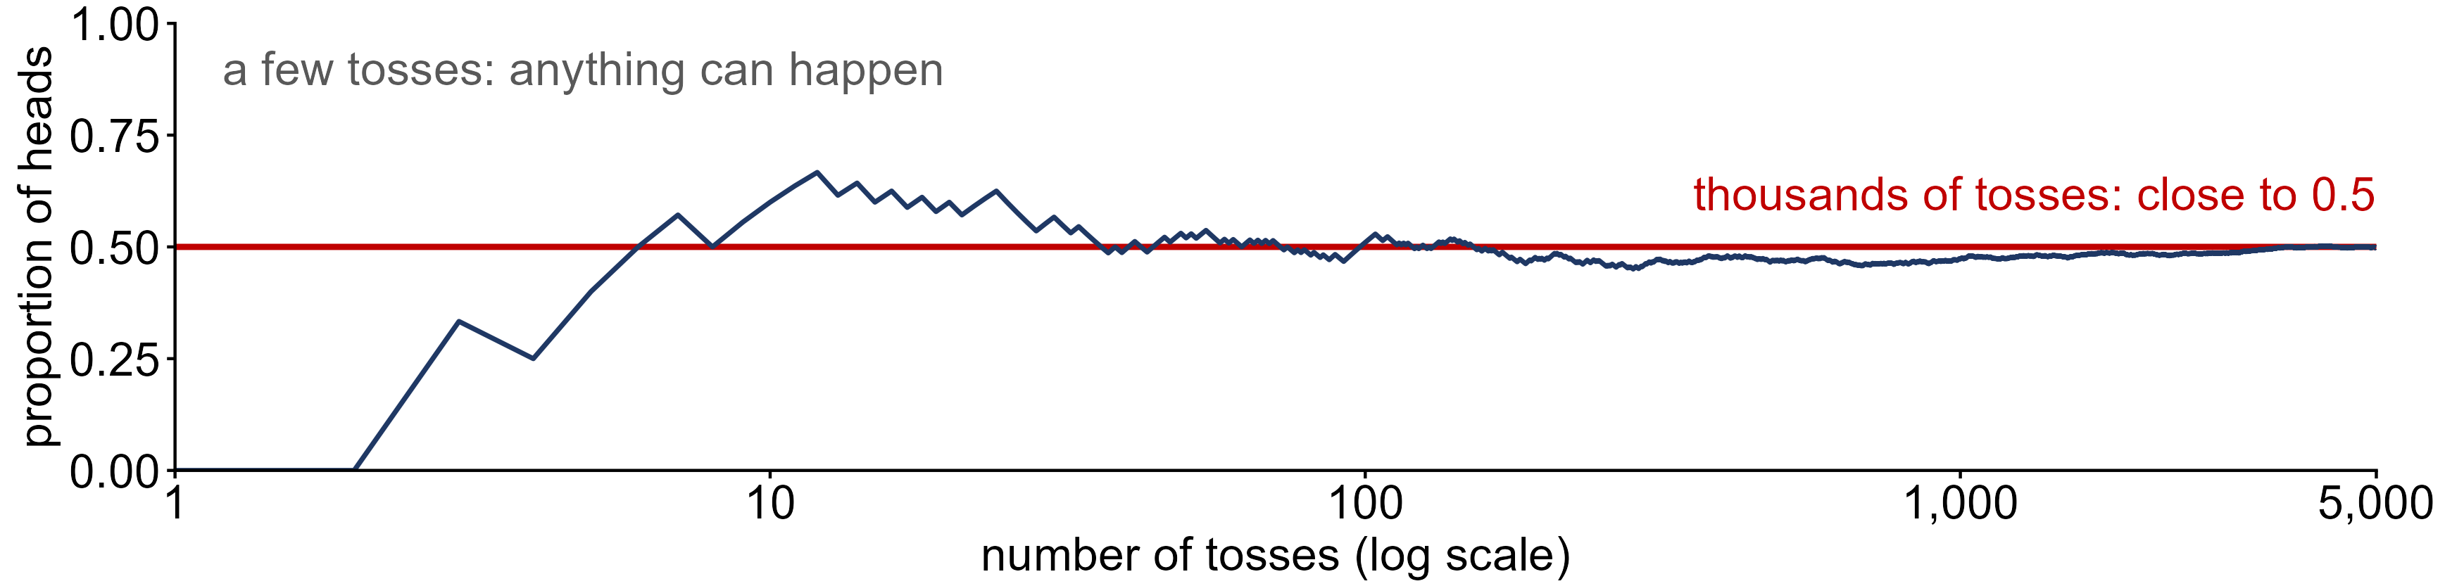
The law of large numbers
law of large numbers
as the number of independent trials n increases, the relative frequency of an event, (number of times A occurs) / n, gets closer and closer to P(A)
Independent trials: the outcome of one trial does not affect the outcome of any other
Jacob Bernoulli proved it (published 1713); Karl Pearson tossed a coin 24,000 times: 12,012 heads = 0.5005

Slide 13
The rules of probability
Rule 1: 0 ≤ P(A) ≤ 1
the probability of an event must be a value between 0 and 1
Rule 2: Σ P(A_{i}) = 1
the probabilities of all the outcomes in the sample space must add to 1
Rule 3: P(A ∪ B) = P(A) + P(B)
the addition rule for DISJOINT events: A and B have no outcomes in common
Rule 4: P(A′) = 1 − P(A)
the complement rule: A′ ("A-not") is every outcome in S that is not in A

Slide 14
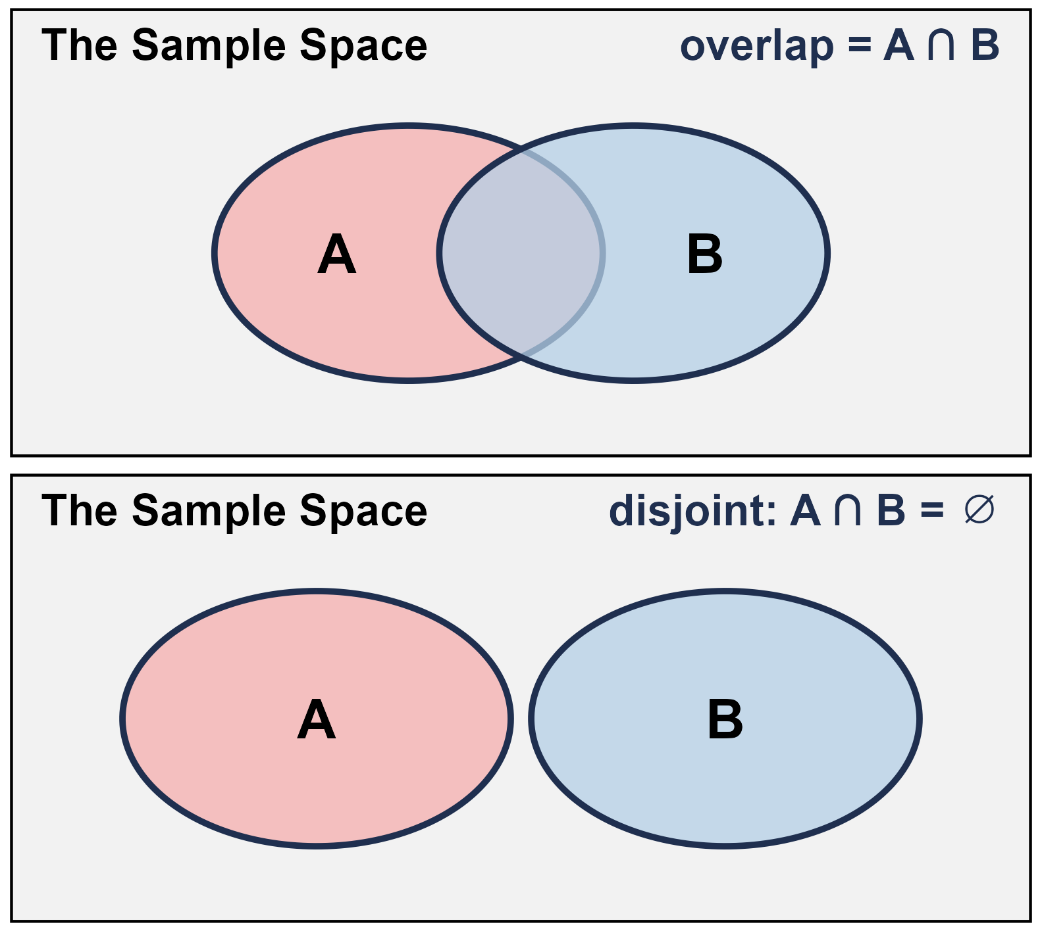
Combining two events
union A ∪ B
outcomes in A or in B (or both); key word "or"
intersection A ∩ B
outcomes A and B have in common; key word "and"
disjoint (mutually exclusive)
A and B have no outcomes in common: A ∩ B = ∅

